Slide 1

Growth and development of School Age
6-12 yrs.
Middle Childhood
Third Stage
Dr. Moustafa Alshammari
Growth and Developments

Slide 2
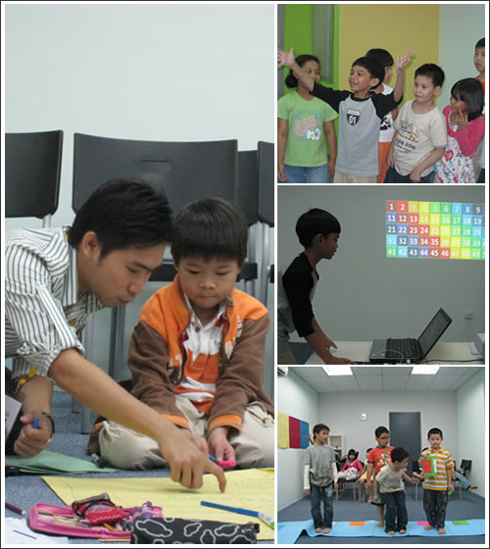
Learning Objectives:
Mastery of content in this chapter will enable the student to:
1. Describe the normal growth and development pattern and common parental concerns of the school-age period.
2. Assess a school-age child for normal growth and development milestones.
3. Formulate nursing diagnoses for the family of a school-age child.
4. Use critical thinking to analyze ways in which the care of the school-age child can be more family centered
5. Integrate knowledge of school-age growth and development with the nursing process to achieve quality child health nursing care.

Slide 3
School Age (6 -12 years)
School Age is Characterized by:
Gradual growth
Motor skills
Advances in thinking
Child begins to interact with people
Individual differences become more evident

Slide 4
Physical Growth
Weight:
School age child gains about 3.8Kg/year. Boys tend to gain slightly more weight through 12 years because they grow in muscles
Formula for 7 to 12 years is:
(age in years X7)-5 =Kg
2

Slide 5
Height:
Gains about 5 cm/year. 135-150 cm at the end of school age (Triples his birth length)
Body proportion during this period: both boys and girls are long-legged.
Dentition:
During school age period, permanent teeth erupt, starting from 6 years. (Usually, permanent teeth eruption in the same order as primary teeth lost).

Slide 6
Physiological Growth:
Pulse: 90 ± 15 beats /min (75 to 105).
Respiration: 21± 3c/min (18 - 24)
Blood pressure: 100/60 ± 16/10
School age child tires easily due to lung capacity.
Immune system reaches as normal adult.
Nervous system is mature by (10) years

Slide 7
Cont Physiological Growth
By 6 years. The overall appearance of the child is different from that of preschool.
The school age child is generally taller & thinner than preschool age.
The size of the head gradually increased. The average circumference is 51.25 cm at 6 years and 53.75 cm(20.5 in at 6 years and 21.5 in) at 12 years.
The face changes slightly.

Slide 8
Motor Development:
Fine | Gross | Age
Knows left hand from right. Improve eye-hand coordination. Can undress him-self. Draws a person (12-16 parts, details). Can brush and comb hair. | Runs, jumps, climbs, and hops, is in constant motion which is clumsy, and awkward Rides tricycle using pedals. | 6 - 8 yrs

Slide 9
Fine | Gross | Age
Increased smoothness and speed in fine motor control. Handles eating utensils (spoon, fork, knife skillfully. Bathes himself with assistance | Throws ball skill- fully. Beings to participate in organized sports. | 8-10 yrs

Slide 10
Fine | Gross | Age
Motor coordination continues to improve, children perfect their muscular skills and coordination in games such as "Football". Sufficient fine motor control for activities are reached through (building models or sewing). | Enjoys all physical activities. | 10 - 12 yrs

Slide 11
Language Development:
Vocabulary expands by 200.000 to 300.000 words.
Sentence structure and use of grammar continue to improve.
Speech proceeds from egocentric to social.

Slide 12
Cognitive Development:
PIAGET CALLS IT Concrete operations PERIOD
Organize facts about the environment to use for problem solving.
Child changes from egocentric interaction to cooperative interaction

Slide 13
Abilities of the school age child
Increase understanding of concept: (Mass, volume, weight and measurement)
Think and give reasons as he develops concept of (cause-effect) relationship and can manipulate symbols, there for can solve problems.
Classify objects to classes and subclasses as they can see the difference more than the similarities objects.
Ordering, i.e. arrange things according to their sizes and relationship to other things.

Slide 14
Reading skills are developed
Tells time; knows date, month and season.
Learns about cause-effect relationship e.g. knows that a stone will not float because it is heavier than water.
Develops an awareness and understanding of other people
By 12 years, are motivated by inner drive rather than pears competition they like to talk, to discuss different subjects and to debate.

Slide 15
Emotional Development:
Fears injury to body, and fear of dark.
Jealous of siblings (especially 6-8 years old child)
Curious about every thing
By 10 years of age, he has short bursts of anger, but able to control anger by 12 years.

Slide 16
Social development
  Play
  Socialization
  Social adjustment
  Temperament
  Communication
  Discipline

Slide 17
Psychosocial and Psychosexual Development
Freud believed the child entered a latency stage.
Psychosexual concerns no longer existed.
During this period, libidinal energies are reduced dramatically and increase physical and intellectual activities.
Erickson Explain School age (Industry versus inferiority)

Slide 18
child desires to engage in tasks in the real world (as he enjoys doing socially useful tasks for others).
Mastery of social interaction facilitates development of the sense of industry and child's feeling of competence, which leads to positive sense of self.
If the child fails to achieve sense of industry, he will develop a sense of inferiority.
The child's energy is directed toward inventions and production.
Beginning to create, develop, and manipulate.
Developing sense of competence and perseverance.

Slide 19
Adaptive mechanisms:
  Regression It is Reverting to an earlier development stage.
Rationalization An attempt to justify behavior by logical reason
Ritualistic behavior Very important but does not persist for long time. (It is performance of formal acts e.g. the observance of actions or procedures in a set, order, and ceremonial way)
Malingering It is pretending to be ill rather than facing something unpleasant e.g. (Feel sick before exam).

Slide 20
Parents and caregivers can assist school age children to develop psychosocially by:
Recognizing success and providing praise.
Guiding children to perform tasks.
Guiding to complete the task.
Teaching the child how to get along with peers by collaborating, compromising, cooperating and competing.
Teaching the child how to get along with adults.

Slide 21
Moral Development:
*Behavior based on familiar and peer group believes.
*Children act to avoid being punished.
*Do things to benefit them selves.
*Fairness concept becomes important.
*Shift from interest of individual to interest of group.

Slide 22
Spiritual Development:
*Learn to distinguish fantasy from fact.
*Understand the creation of the world, think of God as having human qualities e.g. kind, and a person who punishes.
*At school age, some children respect religion, and continue to accept it
This decision is largely influenced by parents → continues religious training.
Child is ready to apply reason rather than blind belief in most situation.

Slide 23
Health Assessment:
Safety from accidents.
Nutrition: balanced diet.
Elimination: Enuresis.
Rest and sleep 8 -12 hours.
Activity / exercise.
Social interaction
Cognitive stimulation

Slide 24
Common Health Problems:
Accidents continue to be common in school aged children.
Communicable disease: due to interactions with other children in school.
Learning disability (LD) difficulty listening, reading, writing.
Enuresis (bed wetting) usually at night.

Slide 25
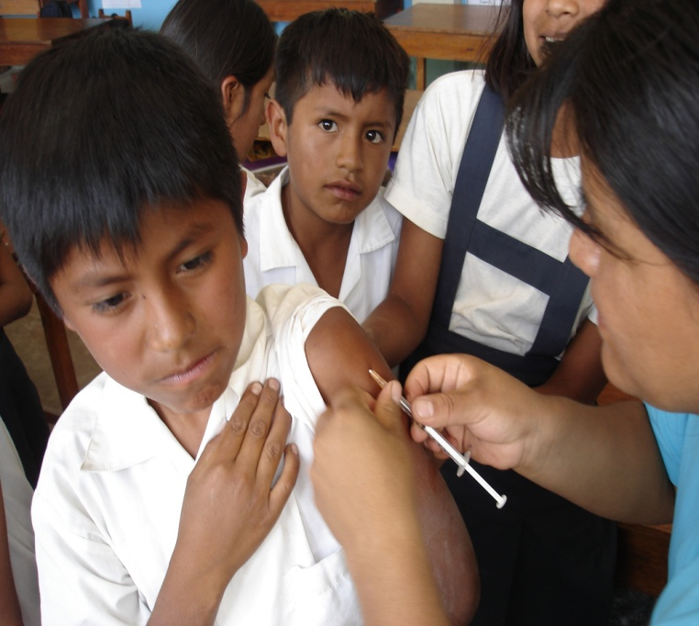
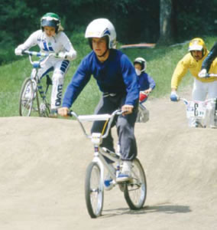
Health protection
Immunization
Injury prevention

Slide 26
Health promotion
Exercise
Sleeping patterns
Nutritional requirement
Dental care

Slide 27
Nutritional Needs of the School-Age Child
As coordination improves, the child becomes increasingly active Requires more food to supply necessary energy
The nutritional needs of the school-age child should be met by choosing foods from all food groups
Increased appetite and a tendency to go on food “jags” are typical

Slide 28
Selected health problems
Fears
Dysfunction of bowel and bladder control
Question related to sex
School phobia
Enuresis
Appendicitis
Common health problems
Accidents
Communicable disease
Learning disability

Slide 29
Nursing Care for the School-Age Child in a Health Care Facility
Explain all procedures to children and their families
Show equipment and material to be used
Outline realistic expectations of procedures and treatments
Answer children’s questions truthfully
Give children an opportunity to verbalize anxieties
Respect desire for privacy

Slide 30
Thank you
رمز الصف
cs5jm5o

